Slide 1
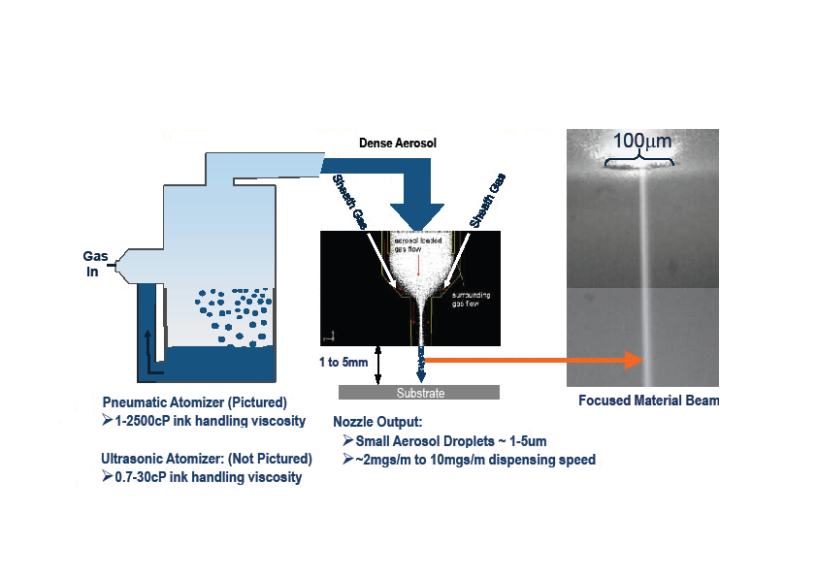
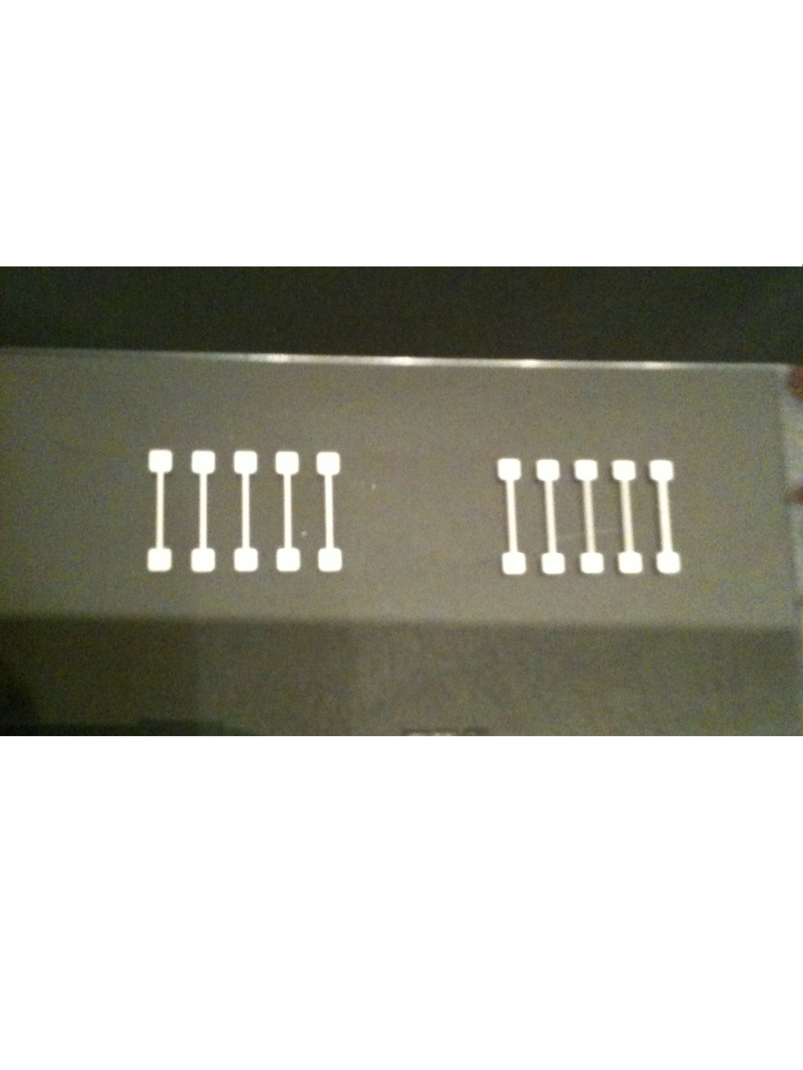
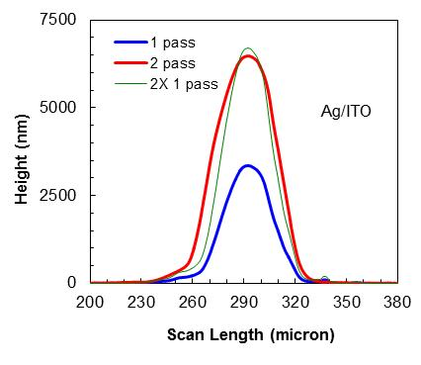
Low-Temperature Printing of Silver Nanoparticle based Metal Grids for Photovoltaic Device Applications
Research Undergraduate
Faculty Advisor
National Science Foundation
Louis J. Kjerstad
University of St. Thomas
Mechanical Engineering
Dr. Jon J. Kellar
South Dakota School of Mines
Metallurgical and Materials Engineering
Research Experience
for Undergraduates
Grant #0852057
Introduction
Objectives
Procedure
Metal grids are critical for effectively collecting photon-generated charge carriers in photovoltaic devices. This research demonstrates how controlled low-temperature and high speed printing as a form of direct writing technology can yield desirable results. Effective requirements for the metal grids in this application include narrow lines that enable large active area on the photovoltaic without compromising fill factor, low process temperatures that are attuned for photovoltaic devices, high conductivity, and efficient low-cost processes.
Low-temperature and high speed printing is an excellent alternative to the heavy chemical use, etching, and clean room required in lithography. OPTOMEC’s Maskless Mesoscale Materials Deposition (M³D) aerosol jet printing (see Figure 1) is a technology suited for the following objectives:
Roughly 50 µm line width
Under 1 µm line thickness
Roughly 5 mm line length
High conductive prints
Adhesion testing
Sinter at low temperatures
For this study, the silver nanoparticles were synthesized using modified Lee’s method.^{[1]} The capping agent was decanoic acid and 60% weight silver was yielded in the final print solution. After collecting the 4-7 nm spherical particles, they were mixed in toluene. The ink solution was injected into the M³D printer. Through ultrasonic waves, the ink solution was atomized and entrained with a gas to form an aerosol consistency. It was printed on the substrate through varying nozzle sizes (250 µm, 200 µm, and 150 µm) which controlled line width. One or two print passes were made on each grid. The final samples were sintered at 160°C, 180°C, 200°C, or 220°C for 20 or 90 minutes.
M³D Aerosol Jet Printing Process
Figure 1*: M³D schematic
Results
Conclusions
Results were conclusive and close to the objectives. Preliminary prints conducted demonstrated parameters which provided the results shown below in Figures 2-5.
Low-temperature printing is an inexpensive option that has the ability to yield viable results within this application. This study demonstrated how metal grids can be written without compromising the large active area on photovoltaic devices while achieving desirable results. It also displayed how controllable this form of direct write printing is. For instance, certain parameters produced features on the metal grids that were predicted within microns. M³D aerosol jet printing poses another advantage as it is an efficient process, taking a small amount of time to complete.
Print results with 150 µm nozzle
45-85 µm width
1.5-7 µm thickness
4.5 mm length
Soft lines making conductivity
recordings difficult
Adhesion testing
indicated strong adhesion
Extended time period and
higher temperature
yielded high conductivity
Figure 2: Standard metal grid
Future Work
1. Prepare and clean the substrate in different manners as to more effectively observe how surface energy affects the print.
2. Use inks with different capping agents to test if the lower sintering temperatures work better for yielding high conductivity and not as soft lines.
3. Conduct more prints with varying parameters such as different capping agent, speed, atomizer, sheath gas, and nozzle size so as to optimize printing results. Utilize SEM and laser profilometry to identify how desired objectives are more or less controlled under particular parameters.
Figure 3: One pass on Indium Tin Oxide (ITO); SEM image
Figure 4: Two passes on ITO; SEM
image
Figure 5*: Laser profilometry
Acknowledgments
Acknowledgments
References
[1]:Lee, K. J., Lee, Y. I., Shim, I. K., Joung, J., & Oh, Y. S. (2006). Direct synthesis and bonding origins of monolayer-protected silver nanocrystals from silver nitrate through in situ ligand exchange. Journal of Colloid and Interface Science, 304, 92-97.
Figure 1*: Renn, Michael. (2008). M³D aerosol-jet-printing—5 microns to 5 millimeters. OPTOMEC professional presentation.
Figure 5*: Produced by Dr. Qi Hua Fan.
Acknowledgments
Special thanks owed to the National Science Foundation, Dr. Jon Kellar, Dr. Michael West, Dr. William Cross, Mr. Krishnamraju Ankireddy, and Mr. James Randle for making this research possible.

